Slide 1

BRITISH AIRWAYS
Predicting customer buying behavior

Slide 2
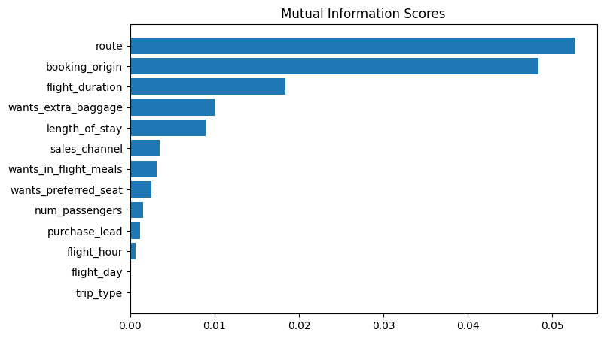
Predictive Model to Understand Factors that Influence Buying Behavior
We have trained the data set with Random forest classifier model and received
ACCURACY: 85.09
AUC score: 0.558
Route
booking_origin
flight_duration
wants_extra_baggage
length_of_stay
are the top 5 features which influence Customer buying behavior

